Slide 1
S-98 Meeting 11th December

Slide 2
Agenda Items [IN PROGRESS]
S-124 Section re-draft [[Chair] [Alarms/Indications for NW]
Issues creating Enhanced Safety Contour [OSI]
Interoperability identifier Use/definition and ECDIS behaviour [Chair / S-101 / NIPWG]
Highlighting and Pick Reports for common FOIDs in the viewport [Chair/S-101]
Baltic Sea eNav [DK]?
Raytheon – outstanding comments [DS]
S-101 – has anything been left out?
Issues from Github [JP]
CATALOG.XML attributes and Processing of cancellations
Follow up TWCWG naming 104/111 / NOAA paper
Area fills and centred symbol placements
CATZOC algorithm modification proposal [FR]
What overlays what? Both options to be considered. Maybe for Appendix D only.
Aboriginal languages in schemas [S-101]
Sun Illumination [Sperry Marine]
S-124 / S-98 interaction [AU / AMSA]
AU – 12.10.2 vertical datum and D-3.5 is a repeat requirement.

Slide 3
Timescales
Following meeting 11th December, draft v2.5.0 to be completed (with inputs if required from PT members). PT can review and provide input for the v2.5.0 in that time as well.
16th Jan (or before), submission to S100WG for review
14th Jan – end of review and aggregation of comments
Comment adjudication up to March 17th
TSM (March 17th onward) to adjudicate any remaining comments and significant issues.
Post TSM version to be submitted to HSSC for approval as v3.0.0
Suggestion is to continue meetings through that time to assist implementers, answer questions and assess comments received to date.

Slide 4
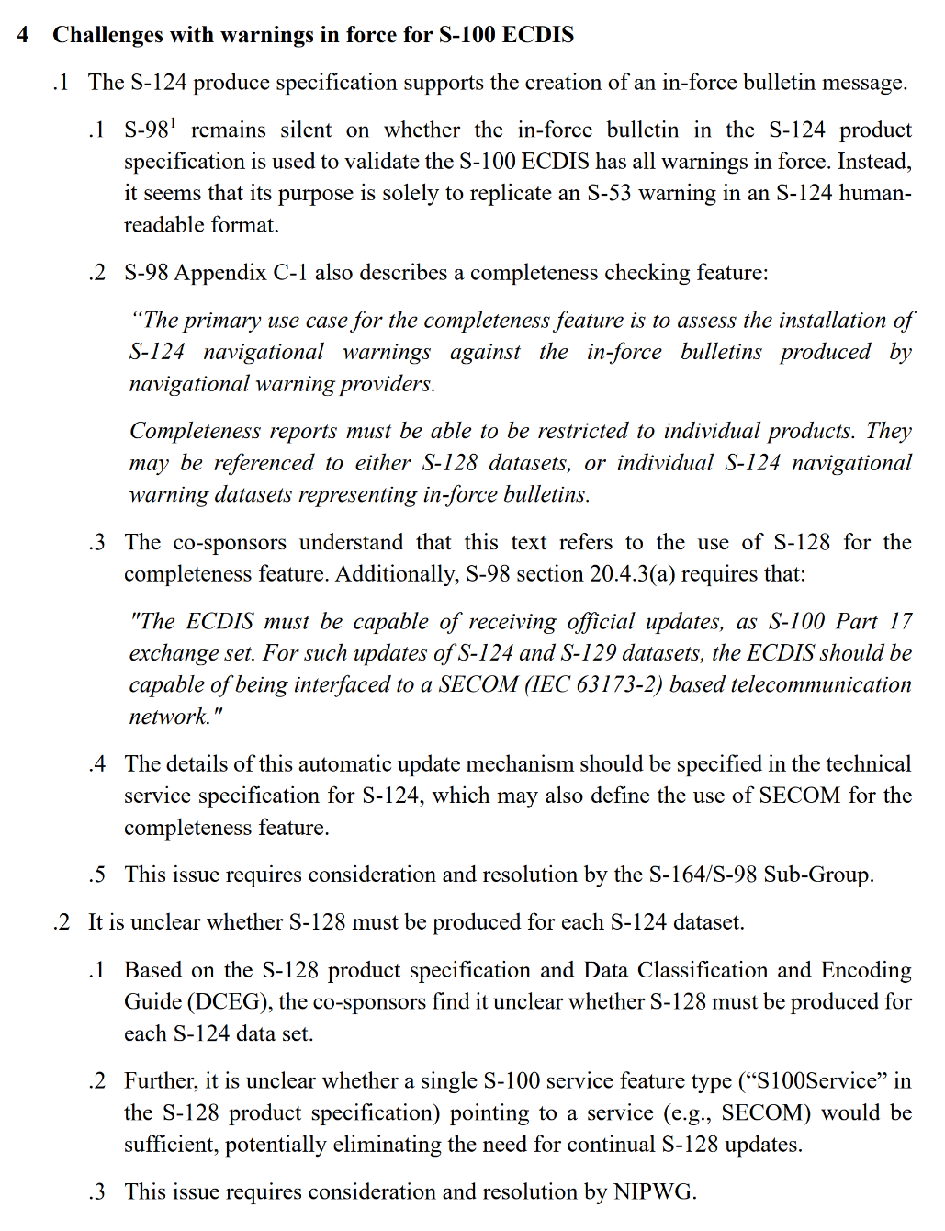
S-124 / S-128
Received from WWNWS vai AU/AMSA
S-98PT is requested to help explain how the use cases/scenarios are handled.

Slide 5
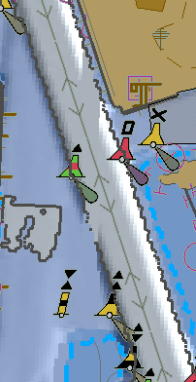
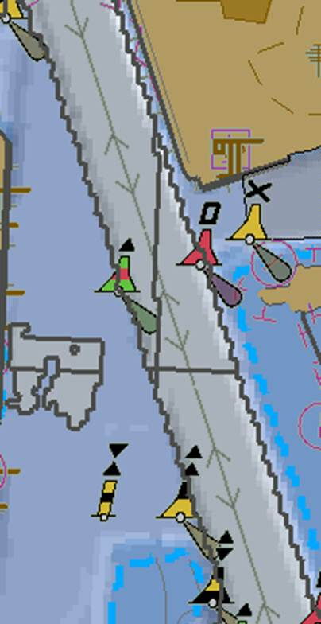
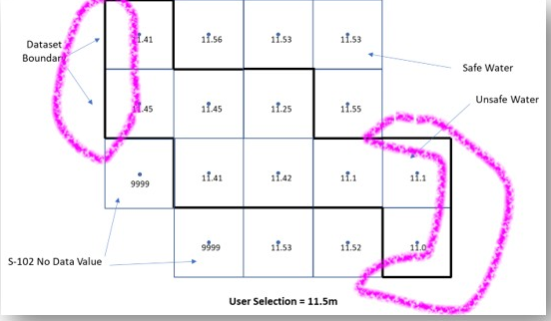
Enhanced Safety contour Issues [OSI]
In the current S-98 Appendix D, the safety contour must be drawn
Where you transition from safe to unsafe water (as defined by the values in the S-102 (+S-104 + uncertainty etc…)
At the edges of the dataset
Between NoData values and Data values.
This leads to a proliferation of safety contours.

Slide 6
Enhanced Safety contour Issues [OSI]
In the current S-98 Appendix D, the safety contour must be drawn
Where you transition from safe to unsafe water (as defined by the values in the S-102 (+S-104 + uncertainty etc…)
At the edges of the dataset
Between NoData values and Data values.
This leads to a proliferation of safety contours.

Slide 7
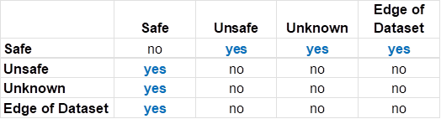
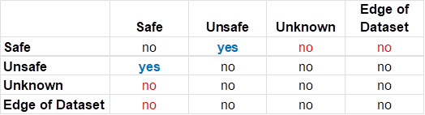

Proposal:
There are 4 cases (dataset regions), so 16 possible transitions (a->b) to consider.
Because A->B is the same as B->A and A->A is “obvious” there’s actually only 6 cases to consider.
These tables show the different possibilities
Current:
Proposal:

Slide 8
Proposal:
So, questions to resolve are:
Edge of dataset, can the ENC data be relied upon to determine safe vs unsafe (yes?)
Unknown (=Fill Value). Should it be assumed that the transition from safe->Fill Value is safe or unsafe?
Thoughts? S-98 can adjust either way.
The current model creates too many safety contours (“too safe”). We don’t want to change things to be “not safe enough”
This is relevant to the “holes” discussion
Current:
Proposal:

Slide 9
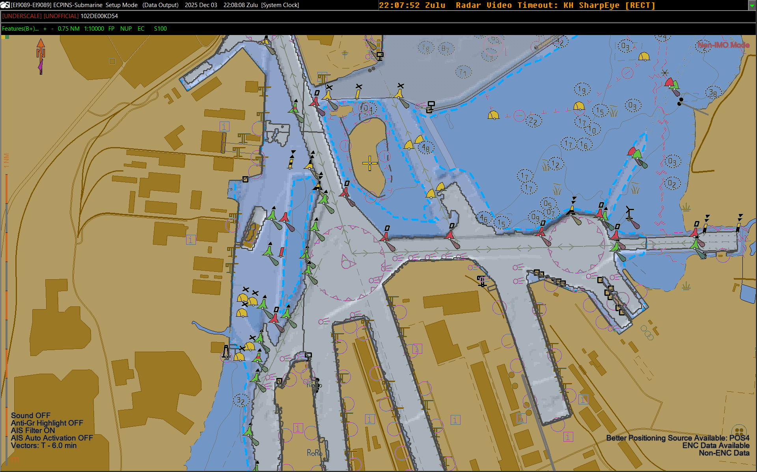

Slide 10
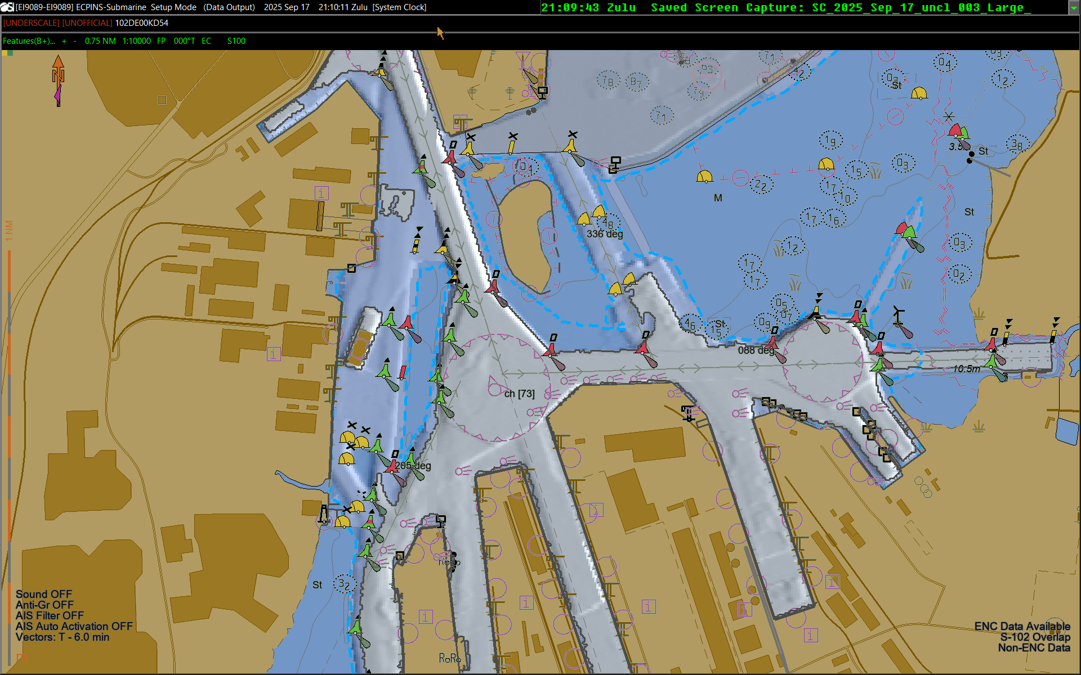

Slide 12
Interoperability Identifier is ECDIS functionality. It is a “join field” – it says which features you want to be grouped together when one of them is picked by the pick report. How does it work when you want the NW information to be returned when the user picks a component of the bridge?
S-101
ENC₁
S-101
ENC₂
S-124
e
association
c
Viewport
b
Bridge
pick
a
d
association
What happens when you do a pick report?
Which features do you get information for [a-e]?

Slide 13
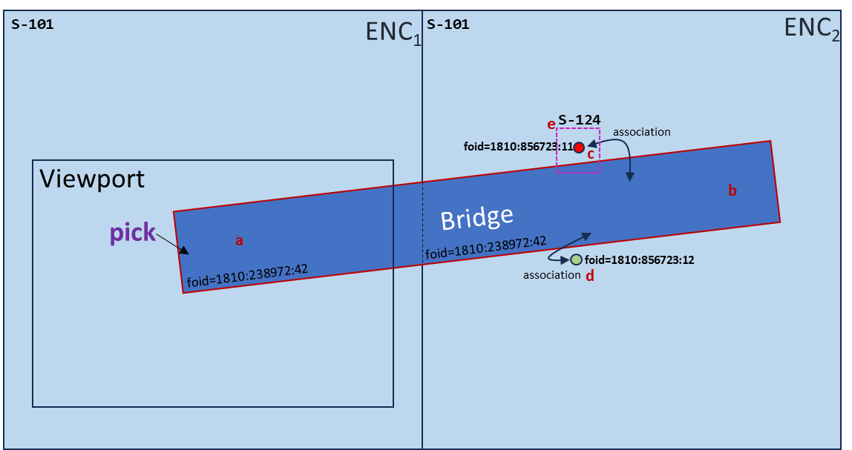
We are trying to do 2 different things:
Identify features (interoperabilityIdentifer does this)
Associate between features in different PS, and also in different datasets (the same PS)
So, interoperablityIdentifier identifies “features”
featureReference.interoperabilityIdentifier contains a reference to “other” identifiers in some product specifications (not all)
The ECDIS must return (in the pick report)
All features with identical interoperabilityIdentifiers
Any feature which has a feature reference containing the interoperabilityIdentifier of the picked feature.
There can be multiple feature references in S-124
How can you associate between different datasets (same PS) Using common foid?

Slide 14
So: Features with common foids in the viewport should be merged together for the pick report?
S-101
ENC₁
S-101
ENC₂
association
c
Viewport
b
Bridge
pick
a
foid=1810:238972:42
foid=1810:238972:42
d
association
What happens when you do a pick report (a)?
Feature picked
Common foid
Associated with (b)
Associated with (b)

Slide 15
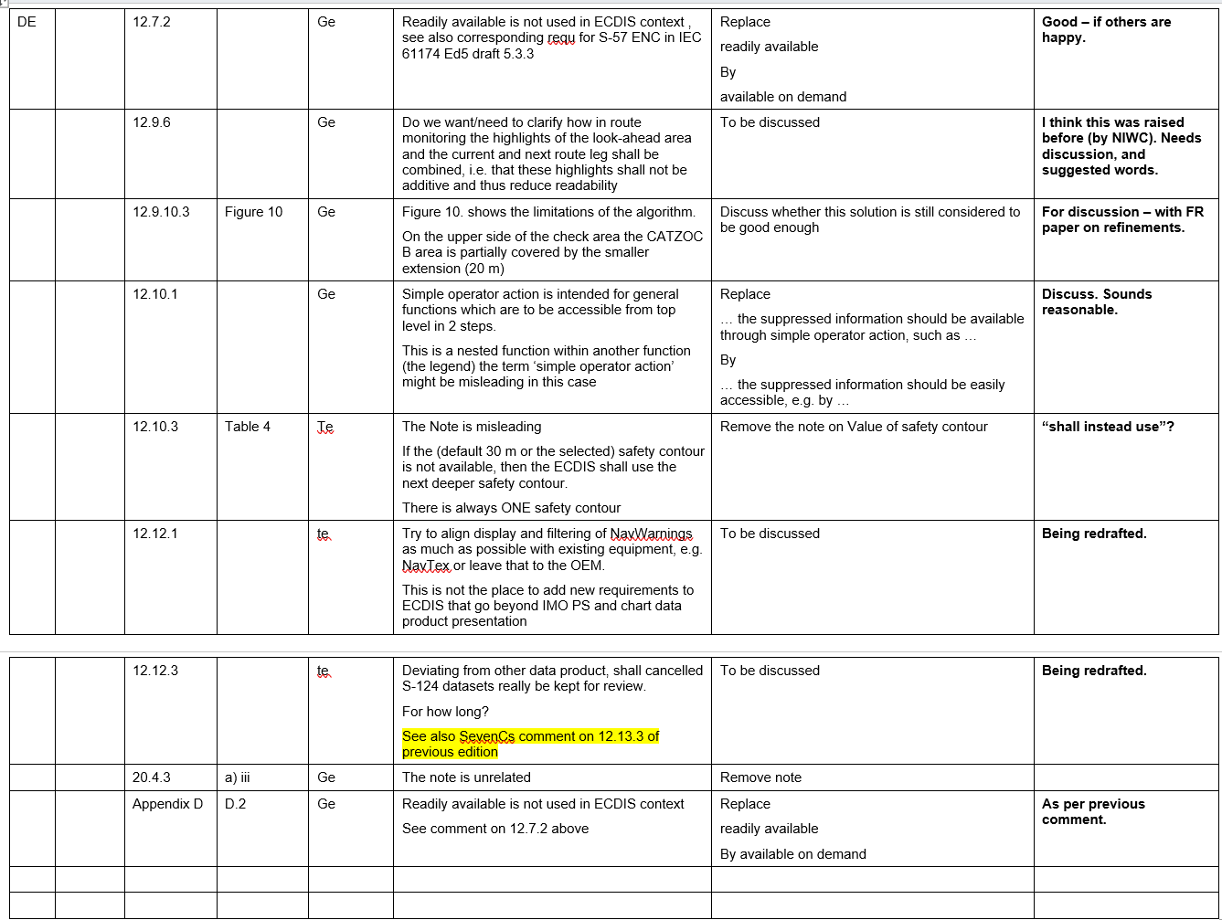

Slide 16
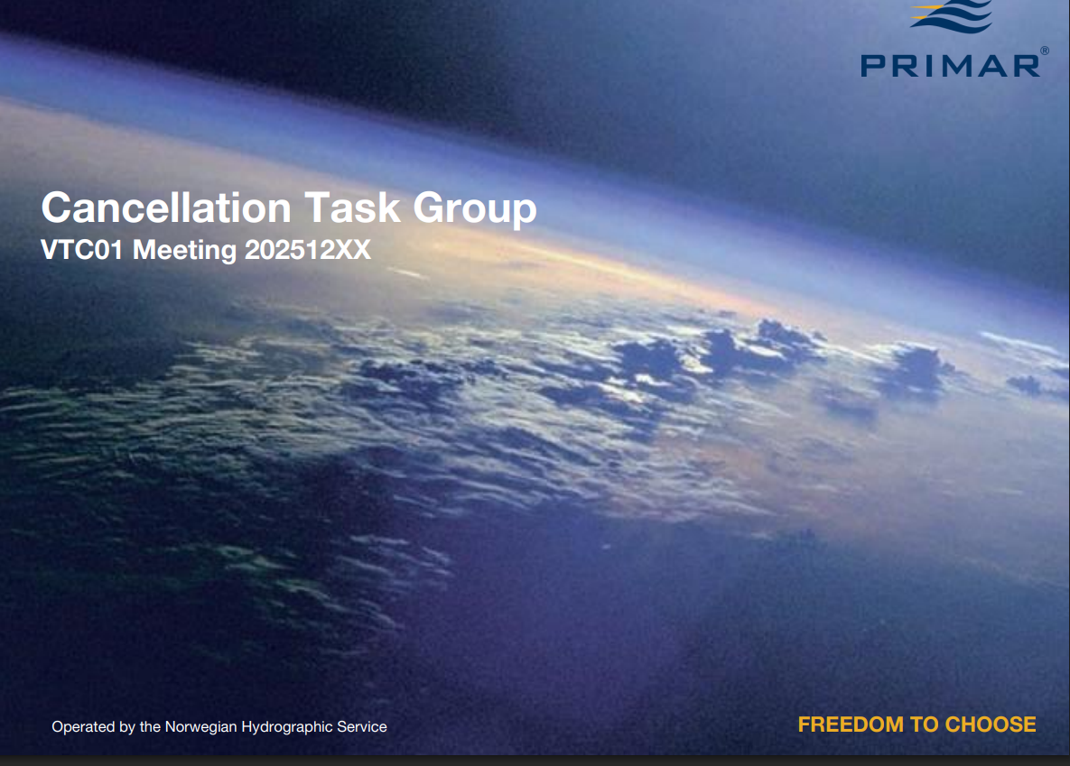

Slide 17
File Naming for S-104 / S-111

Slide 18
S-124 / S-98
3 VTCs on S-124 have been held.
Latest revision of words included in Github folder. Will be added to the S-98 2.5.0.
Next meeting on S-124 PT is 7th Jan. There is time to get outputs from there into the draft, ready for S-98PT to review.
Should there be an “alert” for new NWs as they are added to the system and they are on the current route [received from AU]. Comment for discussion

Slide 19
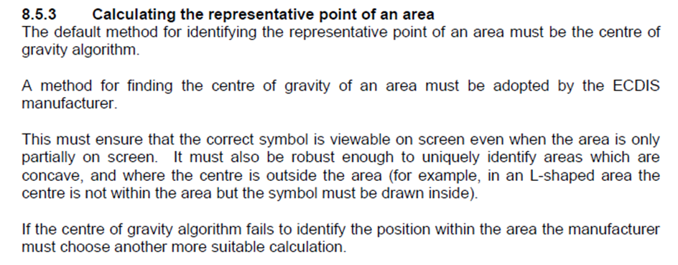
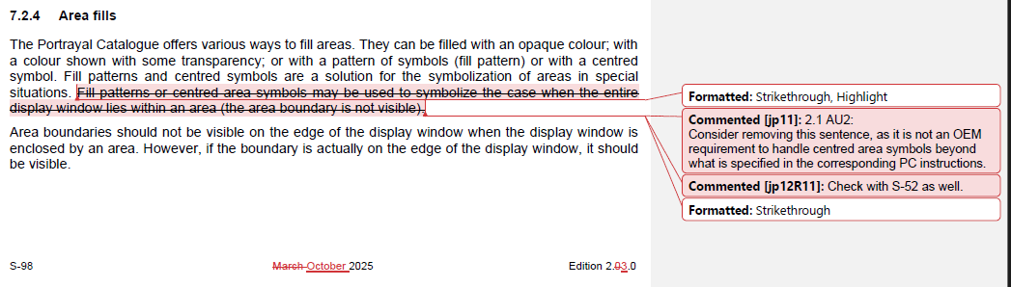
Area Fills

Slide 20
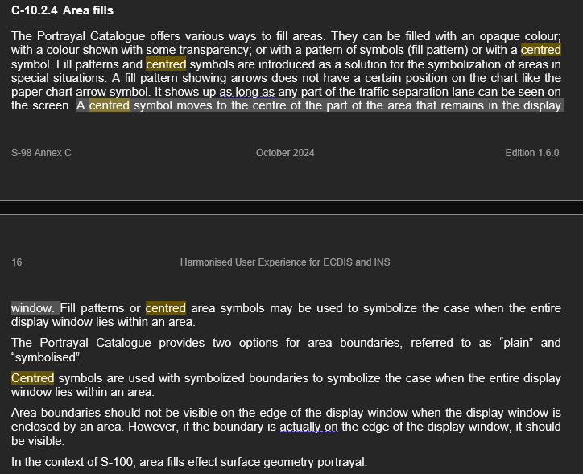
Area Fills
Does the symbol get “recentred” to the visible part of the polygon by OEMs on the screen, or does the symbol drop off the display because the actual center point is now off the visible part of the screen and portrayal catalog has no way of knowing this?

Slide 21
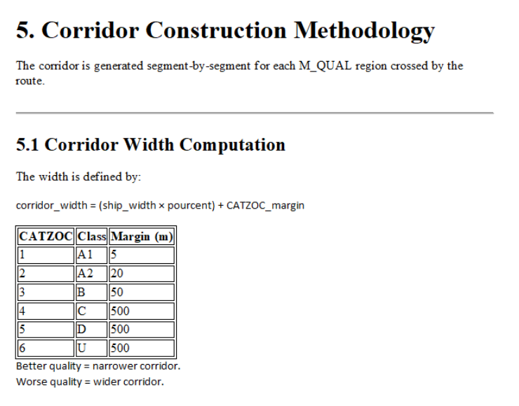
CATZOC / Data Quality [FR]
Paper received with refinements to the algorithm for taking into account CATZOC values
Needs evaluation, then consideration as a proposal for the algorithm currently drafted.
Test data and demo received.

Slide 22
Data Import Rules
When should data be loaded, and if it is, is it marked with the “non-official” border?
Current Rules – in S-98
All certificates must be “valid”, correct format and not expired
All certificates must be authenticated by the scheme administrator
All signatures must be valid. If they are not valid the dataset they sign must not be installed
All catalogues (Feature and Portrayal) must be signed by the Scheme Administrator to be installed
All datasets are marked with the unofficial border unless the role field in the certificate =
DATA_PRODUCER
DATA_AGGREGATOR (RENCS)
Dataset is S-128 and role=AGGREGATOR (distributors)
The “id” data producer integer and alpha code elements in the MRN of at least one of the authenticating certificates must match those contained in the dataset and its CATALOG.XML entry.
Is there still a requirement for “unofficial data” – we think so.
Should unofficial data installs be “warned about” using an SSE code?
Should there be a warning when it is used??
WEND WG – Proposal to cover “what overlaps what?”
Role = SCHEME_ADMINISTRATOR
SA Root Certificate
Subject=urn:mrn:iho:GB00:00540
(DS) Certificate
Issuer=IHO
Role=DATA_PRODUCER
Signature
Dataset
id=GB00,00540

Slide 23
Data Import Rules Proposal
(Add to current rules in S-98)
All ENC Data is loaded according to the algorithm (Appendix E)
Non-ENC Data is only used (portrayed/processed) when MSVS is between the values specified in CATALOG.XML for minimumDisplayScale and maximumDisplayScale
Propose to add to this:
Non-ENC data must only be portrayed over ENC data if:
The data producer of the Non-ENC data is the same as the data producer of the ENC data; or
The ECDIS has imported a certificate issued by the ENC producer with the Non-ENC data producer as its Subject.
Possibly restrict this only to ESC/WLA?
Role = SCHEME_ADMINISTRATOR
Role = SCHEME_ADMINISTRATOR
SA Root Certificate
SA Root Certificate
id=urn:mrn:iho:GB00:00540
id=urn:mrn:iho:GB00:00540
Certificate
Certificate
role
role
Signature
Signature
ENC Dataset
id=XY00,00378
Non-ENC Dataset
id=AB00,00493
overlaps
Subject=urn:mrn:iho:AB00:00493
Certificate
Issuer= urn:mrn:iho:XY00:00378
Role=DATA_PRODUCER

Slide 24
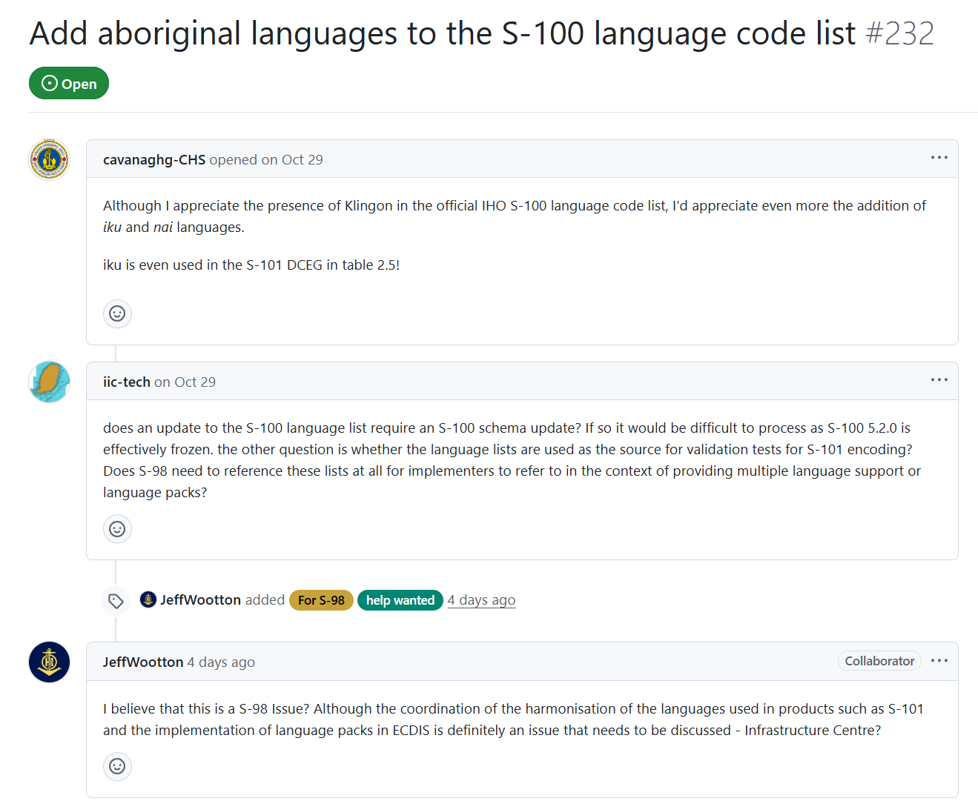

Slide 25
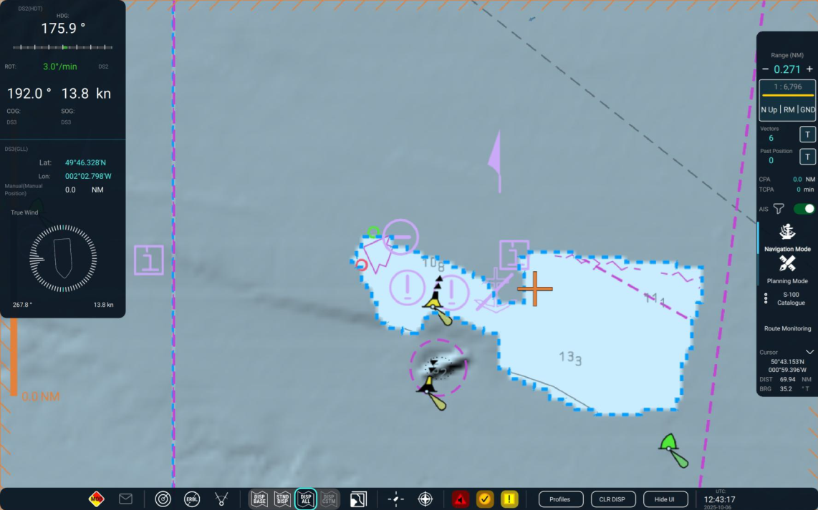
Sun Illumination text
Requirements for sun illumination were added to S-98 in clause 13.3.
However, it seems that these requirements perhaps should go further to ensure that S-102 data does not overlay key chart data.
Clause 13.3 states:
When S-102 is selected for use, in areas where S-102 coverage exists, the S-102 suppresses the drawing instructions associated with the following S-101 depth features
1. Depth Area
2. Dredged Area
3. Depth Contour
This also suppresses the safety contour, the shallow water pattern, the catzoc pattern, text indicating the dredged depth and contour labels.
The sun illumination implementation used for the sea trials may suppress more data than referenced in S-98 Ed 2.4 Appendix D.1. Since Appendix D.1 relates to Enhanced Safety contour only, and not to sun illumination, it seems that clause 13.3 on sun-illumination should be augmented to have the same overlay constraints applied to ensure that the sun-illumination does not inadvertently suppress important ENC information, as it appears to at present

Slide 26
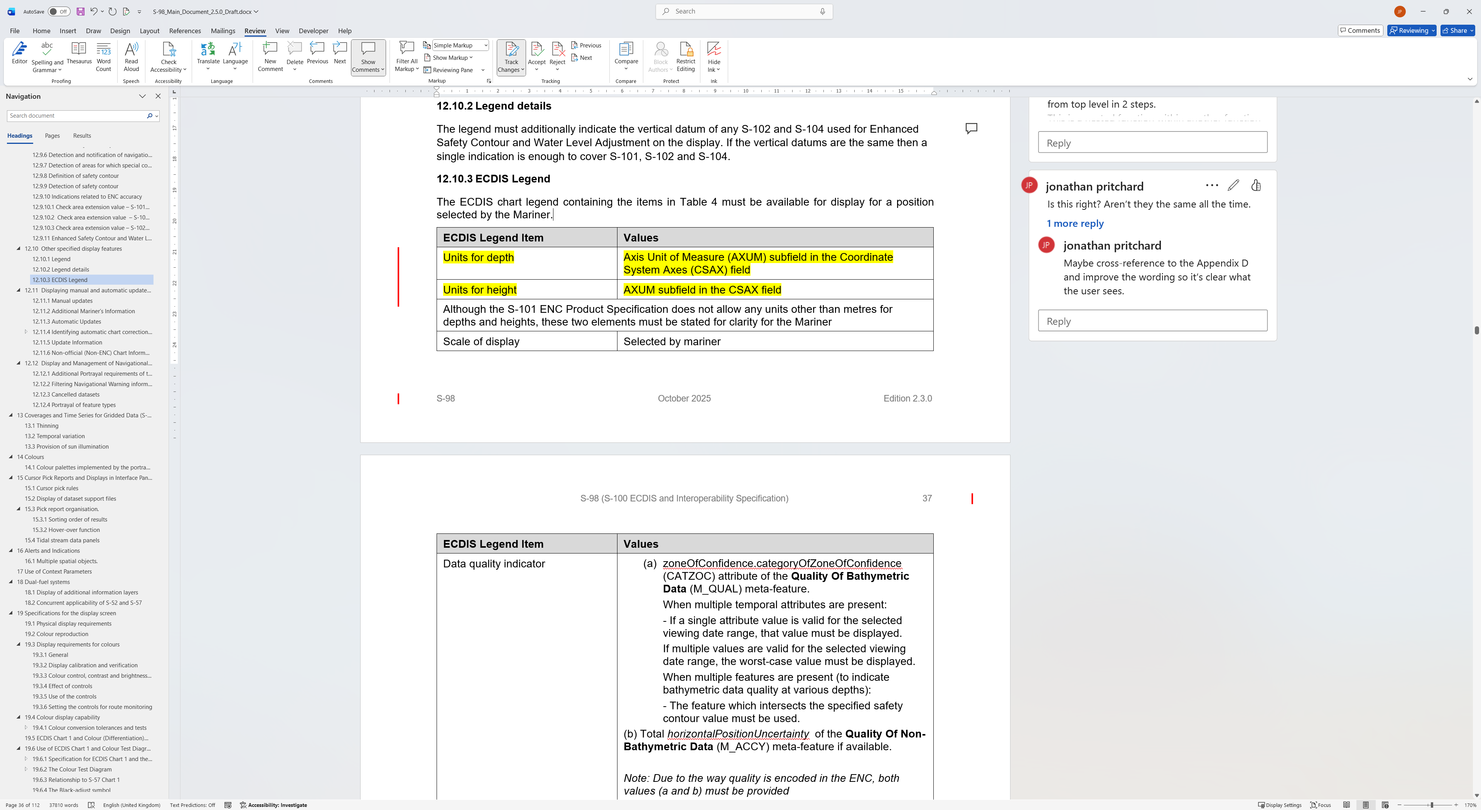
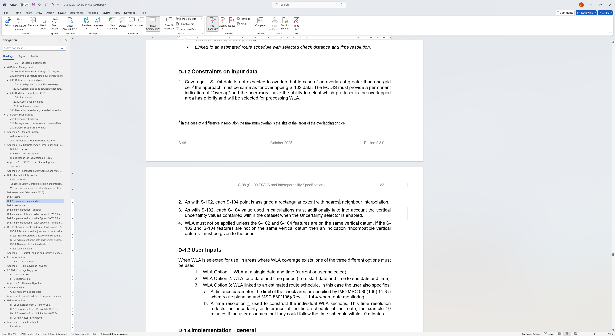
Duplication of requirements
Incompatible vertical datums
Cross-reference, and/or tidy up words.
Appendix D-1.2

